Slide 1
2023 Corporate Human Rights Benchmark
Presentation of key findings

Slide 2
2023 Corporate Human Rights Benchmark
Ranking 110 of the largest apparel and extractive companies, both for the 5th time
In 2022, we assessed 127 companies in three additional sectors:
Food and agriculture,
ICT manufacturing,
Automotive manufacturing.

Slide 3
WBA’s benchmarking cycle

Slide 4
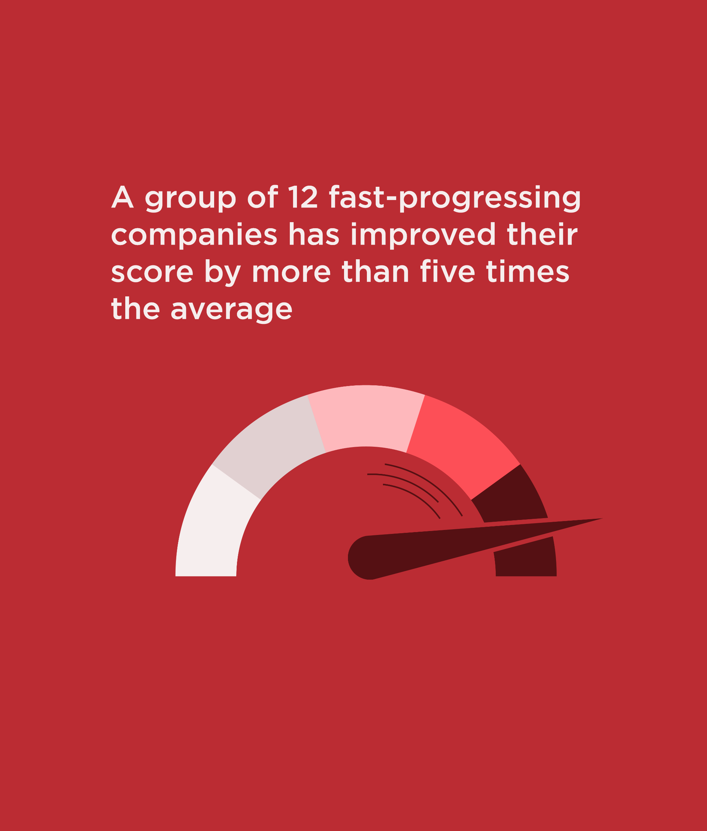
Key findings
Some companies show that transformative change is possible within five years
After five CHRB assessments, most apparel and extractive companies are making progress, with 70% having improved their score since 2018 on key human rights indicators
A group of 12 companies has improved their score by 5x times the average and improved their sector ranking by over ten places. What are they doing differently?
100% of them allocate senior responsibility for day-to-day management of human rights issues (vs. 33% in 2018)
83% assess their salient human rights risks and impacts (vs. 8%)
67% have built internal capacity and provided human rights training (vs. 25%)
83% have grievance mechanisms for external stakeholders (vs. 25%)

Slide 5
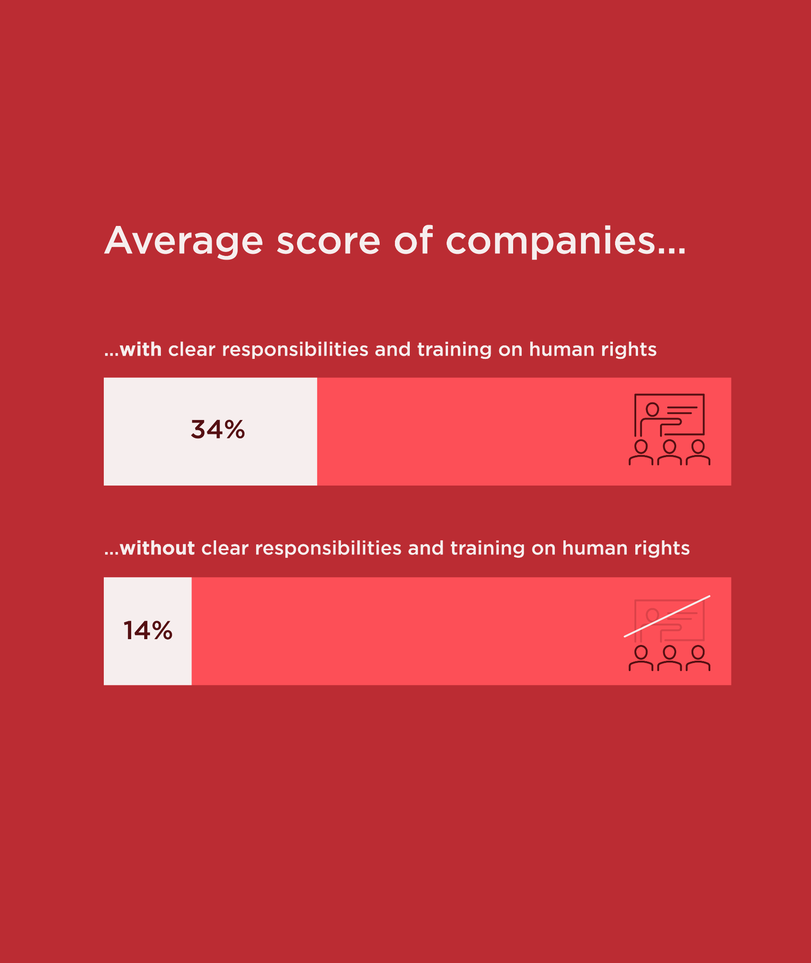
Key findings
2. Clear responsibility and capacity building on human rights is key for translating commitments into action
77% of companies disclose a clear commitment to respect human rights – however, such commitments are only meaningful when translated into action.
Only 50% of the 110 companies disclose how they assign day-to-day responsibility for human rights across different departments
Only 39% provide targeted human rights training to managers and workers
These practices appear key for progress, as companies that do both of these outperform their peers by 150% in the benchmark.

Slide 6
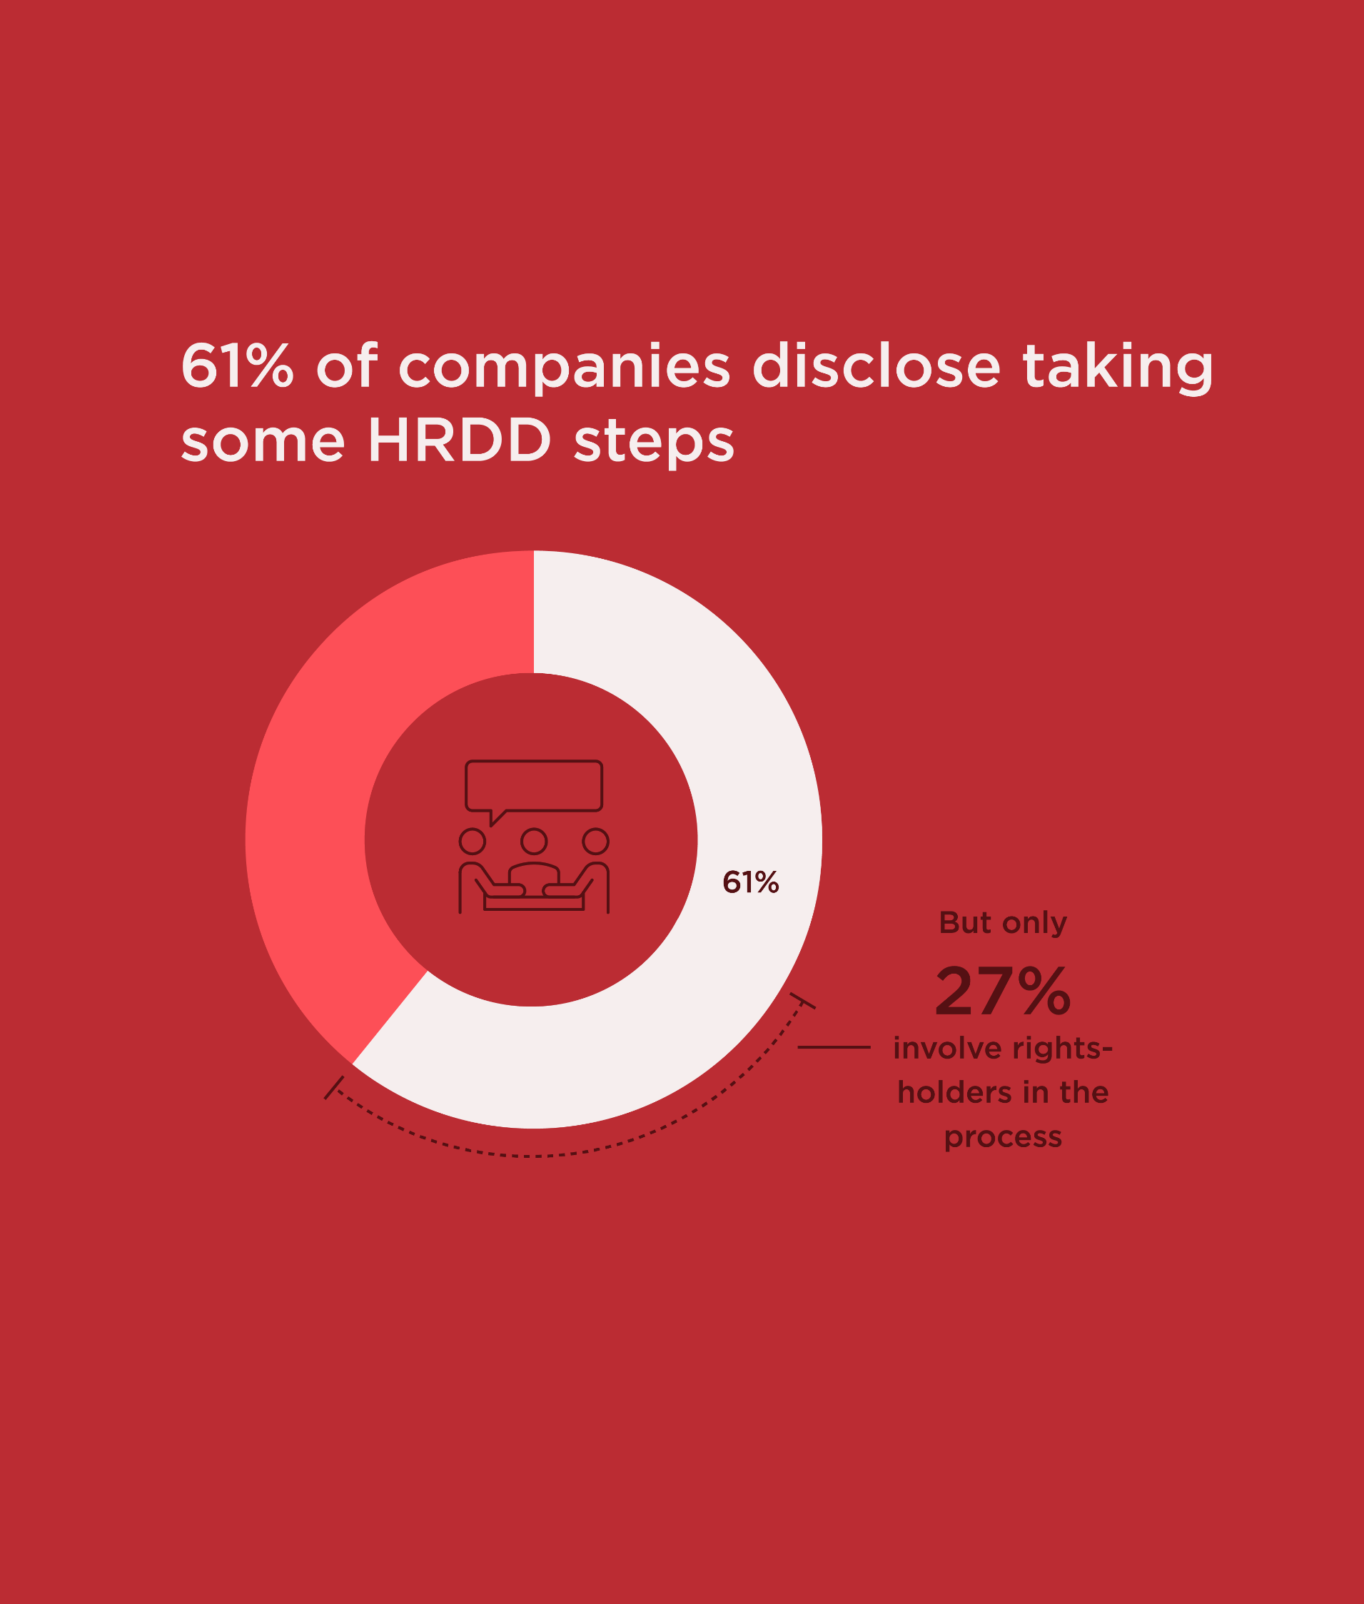
Key findings
3. Most companies fail to include rightsholders in their human rights due diligence (HRDD) processes
61% of extractive and apparel companies demonstrate that they are taking one or more HRDD steps, compared to 51% in 2018.
However, only 27% disclose evidence of engaging rightsholders throughout this process.
This means that more than half (55%) of the HRDD processes we assessed did not include disclosure of consultation with rightsholders.
Notes:
This is reflected by practices of the top ten companies, they all involve rightsholders in their HRDD process while only 20% of the other 100 companies do.

Slide 7
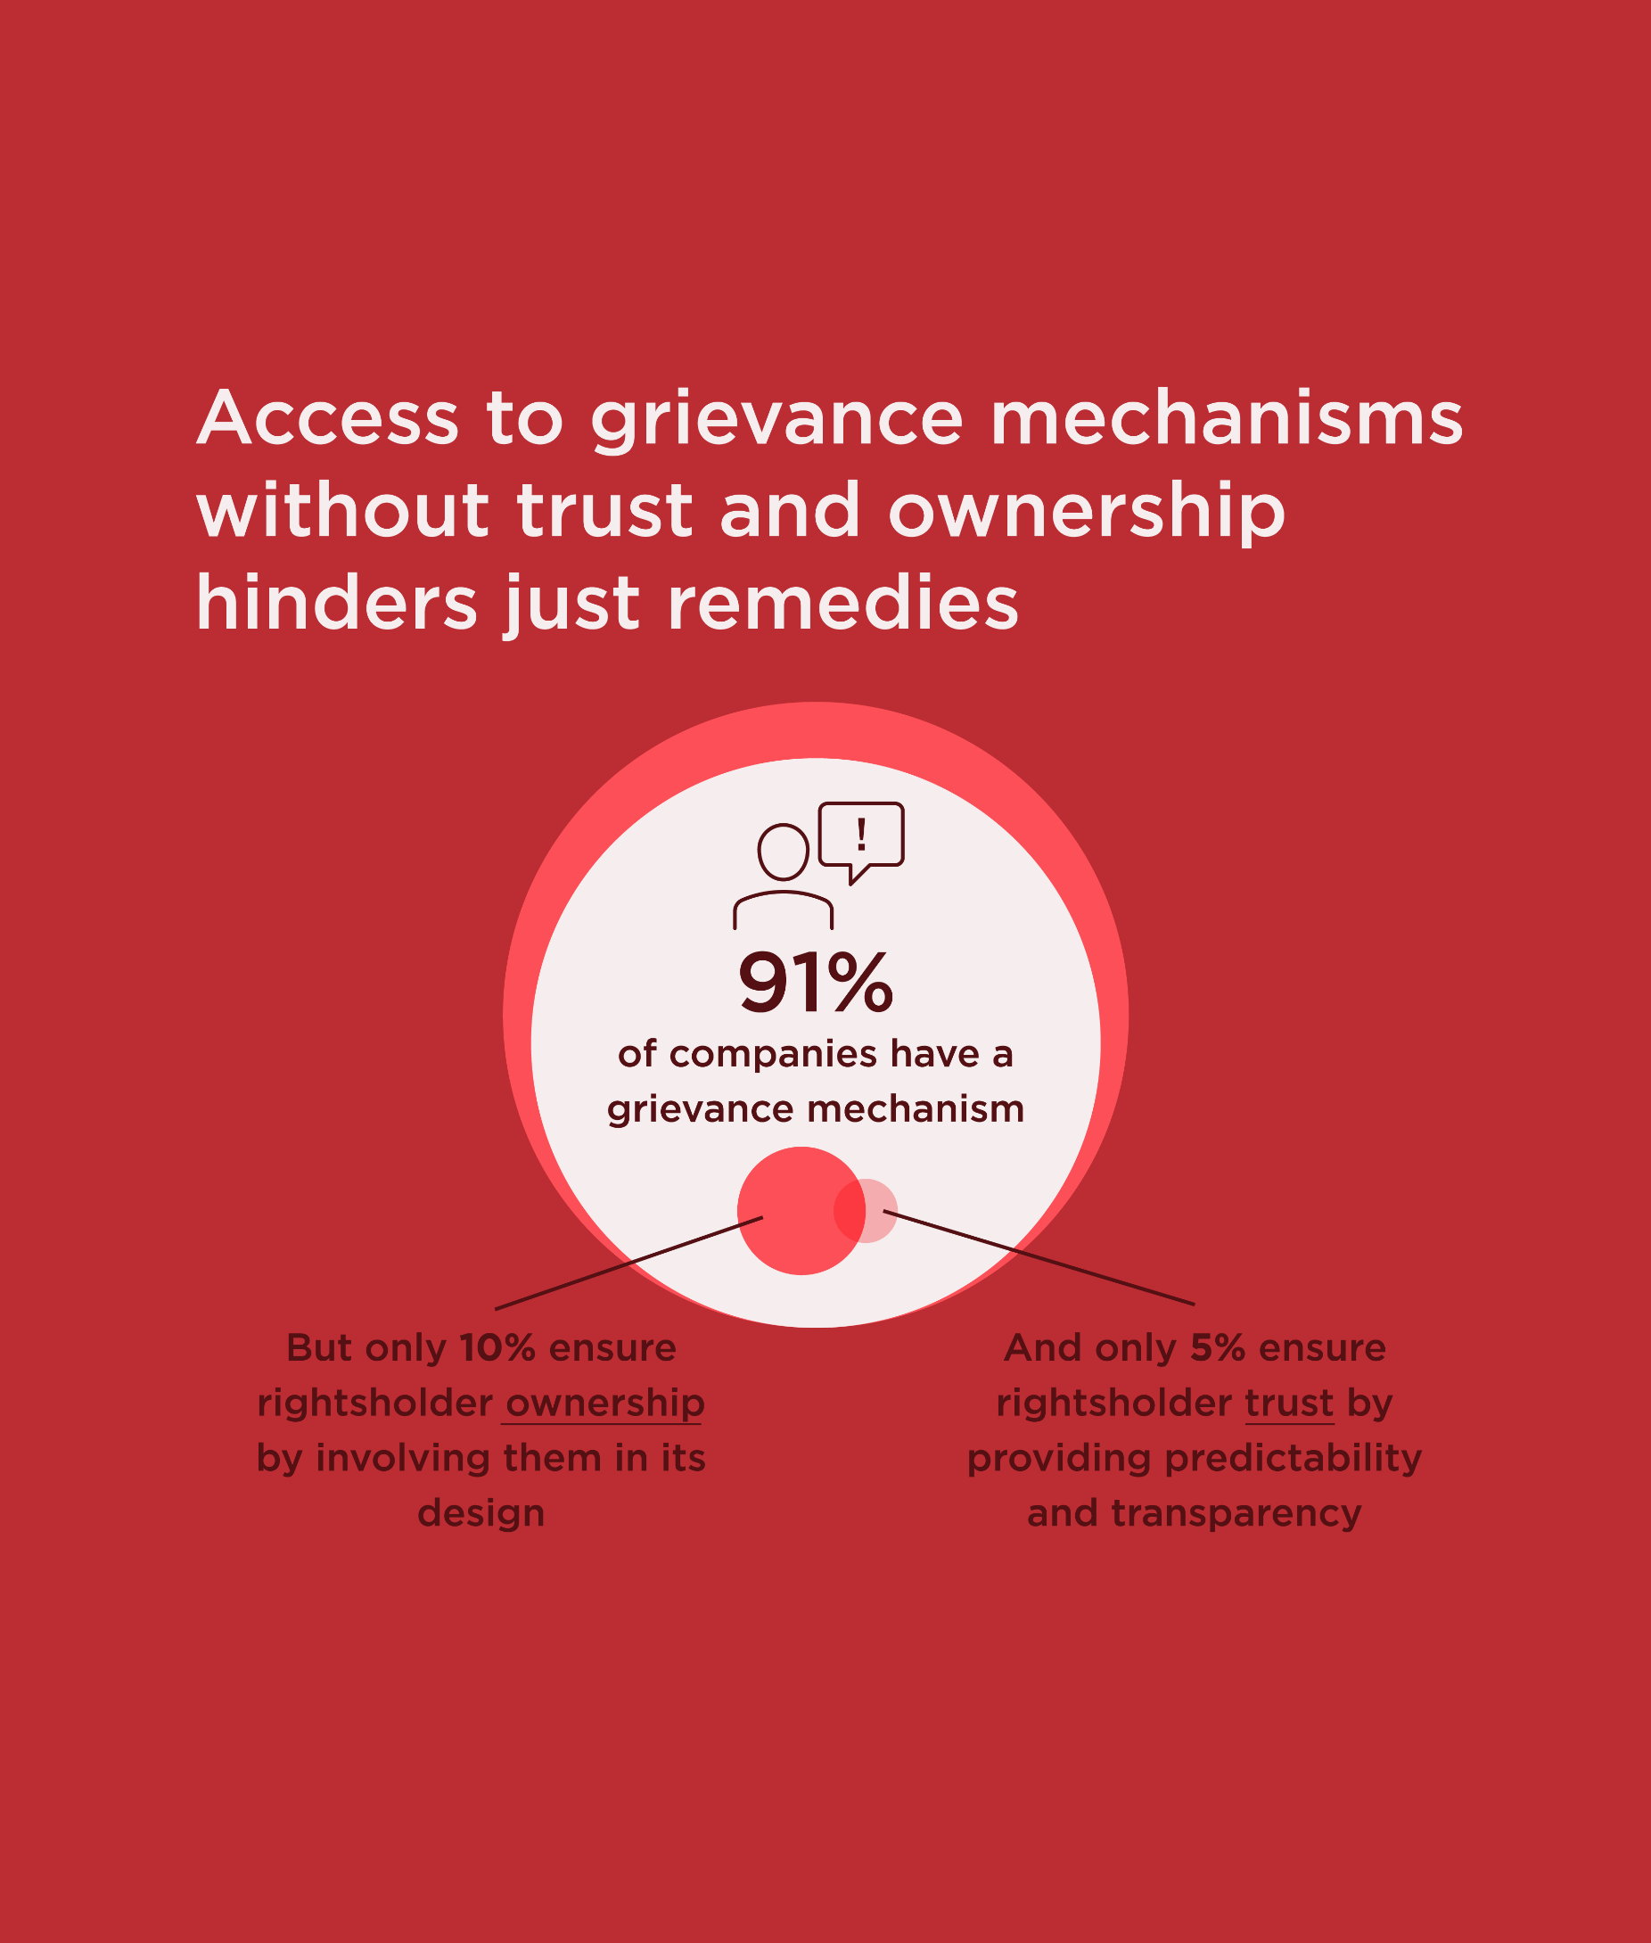
Key findings
4. Access to grievance mechanisms without trust and ownership hinders just remedies
While 91% companies provide access to grievance mechanisms for all workers, and 76% for external stakeholders, most fail to ensure the meaningful participation of rightsholders needed to provide fair remedies.
Only 5% demonstrate building rightsholder trust through providing predictability and transparency regarding procedures, timelines and outcomes,
Only 10% ensure ownership by involving users in the mechanism’s design.
Notes:
The fact that many companies don’t disclose their efforts to ensure meaningful rightsholder participation, by reducing information and power gaps, shows that they often see remediation and resolving complaints as a business risk rather than focusing on the people affected.

Slide 8
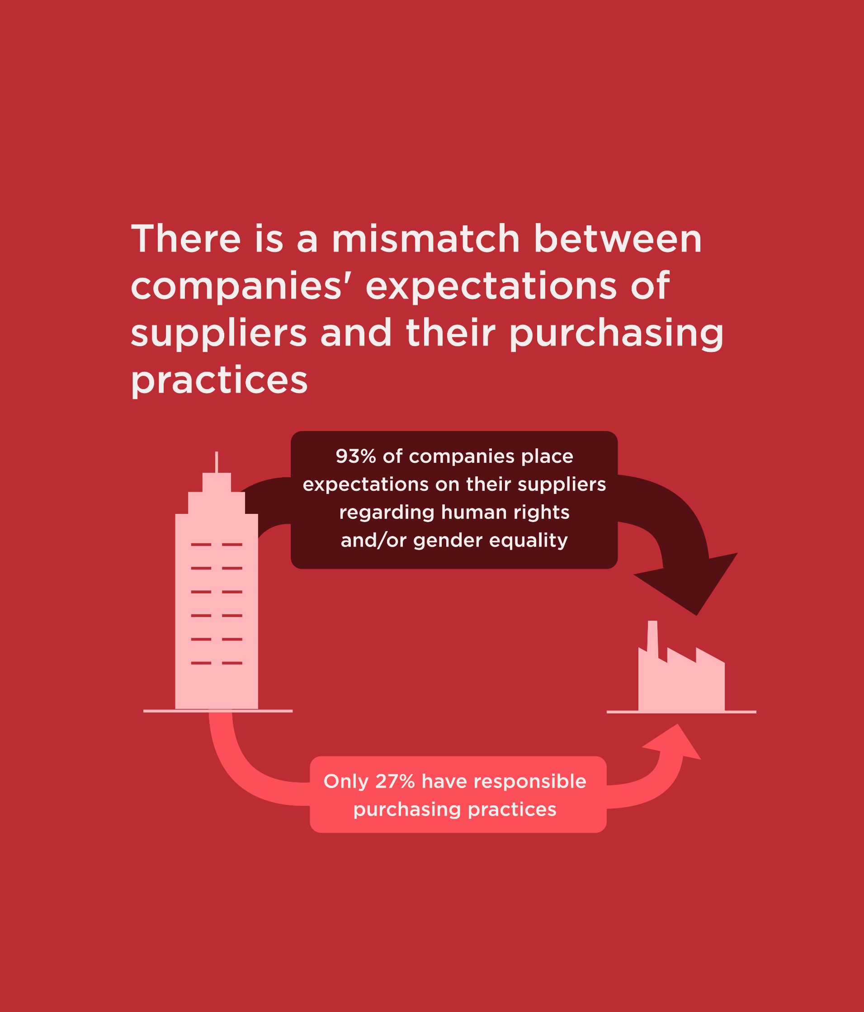
Key findings
5. Suppliers are expected to respect human rights and promote gender equality but are set up to fail by buying companies
93% of companies place expectation on their suppliers regarding human rights and/or gender equality
About half of them provide targeted support for at least one gender equality (45%) or human rights issue (47%).
Only 27% enable their suppliers to meet their human rights and gender equality expectations through responsible purchasing practices, such as avoiding short notice requirements and delayed payments.

Slide 9
Call to action for investors
When engaging companies at the earlier stages of establishing a comprehensive human rights approach, investors can emphasise the importance of internal resource and responsibility allocation, trainings on human rights, and the coverage and quality of grievance mechanisms.
When prioritising companies for engagements on human rights, consider asking laggard companies how responsibility for implementing human rights policy commitments is disseminated beyond senior management level.
As access to grievance mechanisms has largely been achieved, attention needs to shift towards ensuring these mechanisms produce just outcomes. Investors can ask companies how they are ensuring their grievance mechanism facilitates the involvement of rightsholders at all stages.

Slide 10
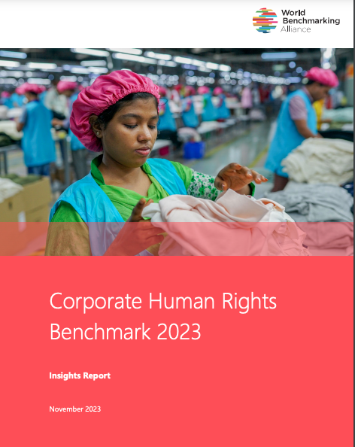
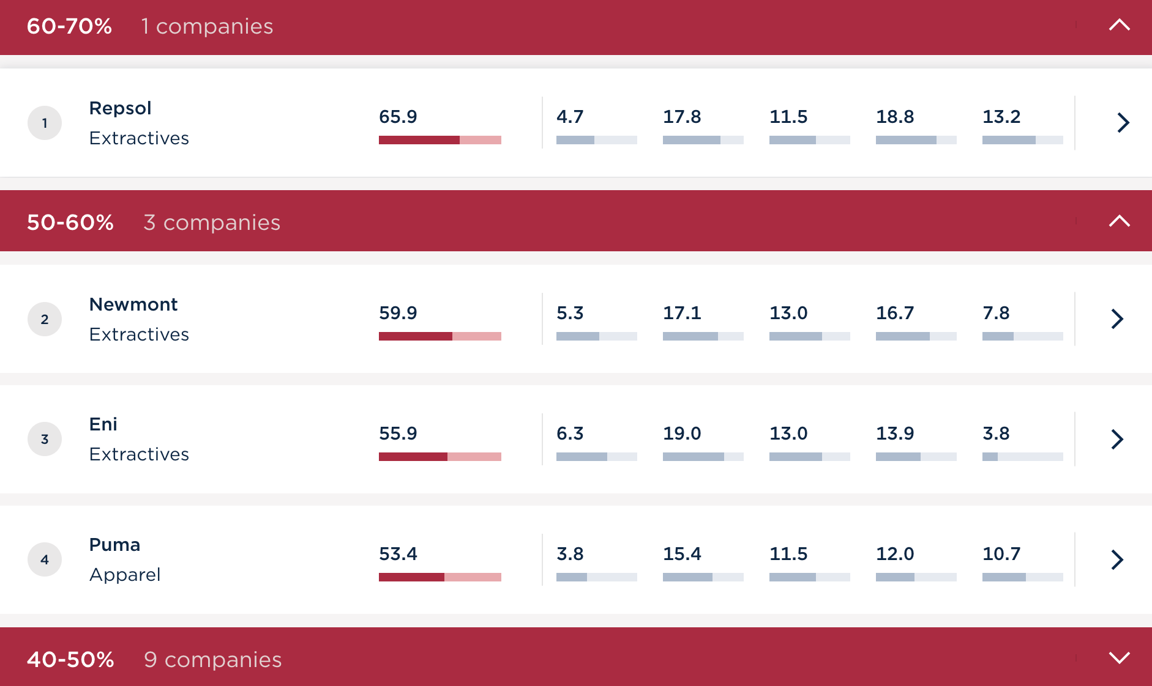
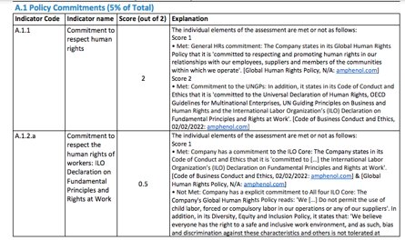
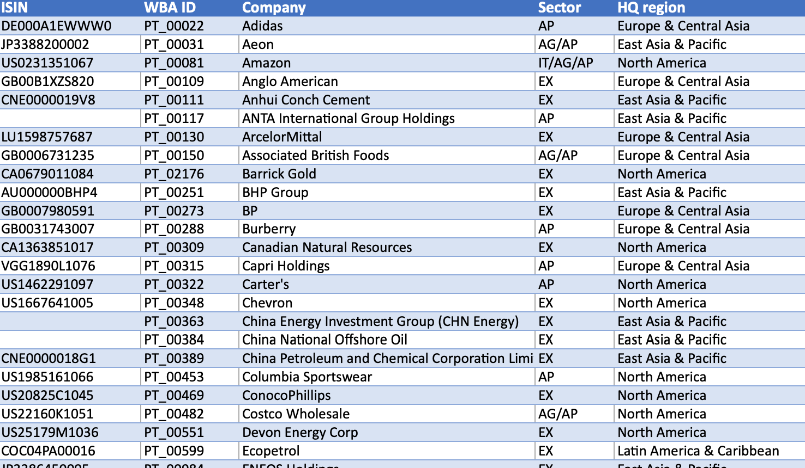
Publicly available resources
What we publish:
Insights report ,
Ranking
Individual scorecards
Detailed data sheet
Methodologies

Slide 11
What’s next?
2024: year of impact and review
In 2024, we will be focusing on further analysing five years of data gathered through the CHRB to provide deeper insights into progress on business and human rights.
We are committed to fostering collaboration and engaging with our stakeholders. We anticipate initiating consultations and offering feedback opportunities in the first half of 2024.
We want your input! How have you been using the CHRB in your work?
WBA is committed to working with all stakeholders to accelerate corporate progress on human rights and gender equality:
Collective Impact Coalitions (CICs)
Communities of Practice
2024 Social Benchmark
.

Slide 12
Thank you!
Contact us at info.social@worldbenchmarkingalliance.org

