Slide 1


The Corporate Responsibility to Respect Human Rights:
HRDD Part 3 – Communication of Responsible Business Conduct to Stakeholders
Thursday, November 14th, 2024

Slide 2



Speakers
Danielle Essink
Engagement Specialist, Robeco
Michelle Langlois
Senior Advisor, Shift
Julie Vallat
VP Human Rights, L'Oréal

Slide 3
Welcome and opening remarks: Rebecca DeWinter Schmitt, Investor Alliance for Human Rights
Assessing Company Reporting and Disclosures on Human Rights Performance and Impact Management
Michelle Langlois, Senior Advisor, Shift
Corporate Case Study: Effective Human Rights Reporting in L'Oréal
Julie Vallat, VP Human Rights, L'Oréal
Investor Engagement with Companies on Human Rights Disclosures
Danielle Essink, Engagement Specialist, Robeco
Q&A / Discussion
Agenda:

Slide 4

Purpose: Systematically explore the elements of the corporate responsibility to respect human rights (CR2R) as framed in the UN Guiding Principles on Business and Human Rights to educate and support investors as they assess and engage with their portfolio companies on their human rights performance.
During five webinars, elements of the CR2R will be examined in greater depth:
1. Human rights policy and governance
2. HRDD Part 1: Context and sector specific approaches to human
rights impact assessment
3. HRDD Part 2: Integrating, tracking, and monitoring human rights
risk management
4. HRDD Part 3: Communication of responsible business conduct to stakeholders
5. Stakeholder engagement and effective grievance processes
CR2R Series

Slide 5

Communication of Responsible Business Conduct to Stakeholders: Spotlight on UN Guiding Principle 21
Companies must "know and show" how they are addressing their human rights impacts, especially if affected stakeholders raise concerns.
Communications can take many forms (stand-alone HRs or sustainability reports and other non-financial disclosures), but formal human rights reporting is required when operations or operating contexts pose risks of severe human rights impacts.
Communications should be frequent, accessible, and relevant to the company's intended audience, especially affected stakeholders.
Information should be sufficient to evaluate the adequacy of responses to human rights impacts.

Slide 6
Coporate Human Rights Benchmark Methodology
Aim of the CHRB: drive corporate accountability and create a pathway for better human rights practices, with a focus on high-risk sectors
Five measurement 'themes':
  Governance and Policy Commitments
  Embedding Respect and Human Rights Due Diligence
  Remedies and Grievance Mechanisms
  Performance: Company Human Rights Practices
  Performance: Response to Serious Allegations
Indicators related to UNGP 21
  External Communication of Human Rights Policies and Practices (B.1.4, B.2.5)
  Engagement on Severe Risks and Mitigation Efforts (B.2.3)
  Importance of Accessible, Clear Reporting on HRs Risks and Measures Taken (B.2.4., B.2.5)

Slide 7
“Know and Show”:
Communicating about human rights
Investor Alliance for Human Rights| 14 November 2024

Slide 8
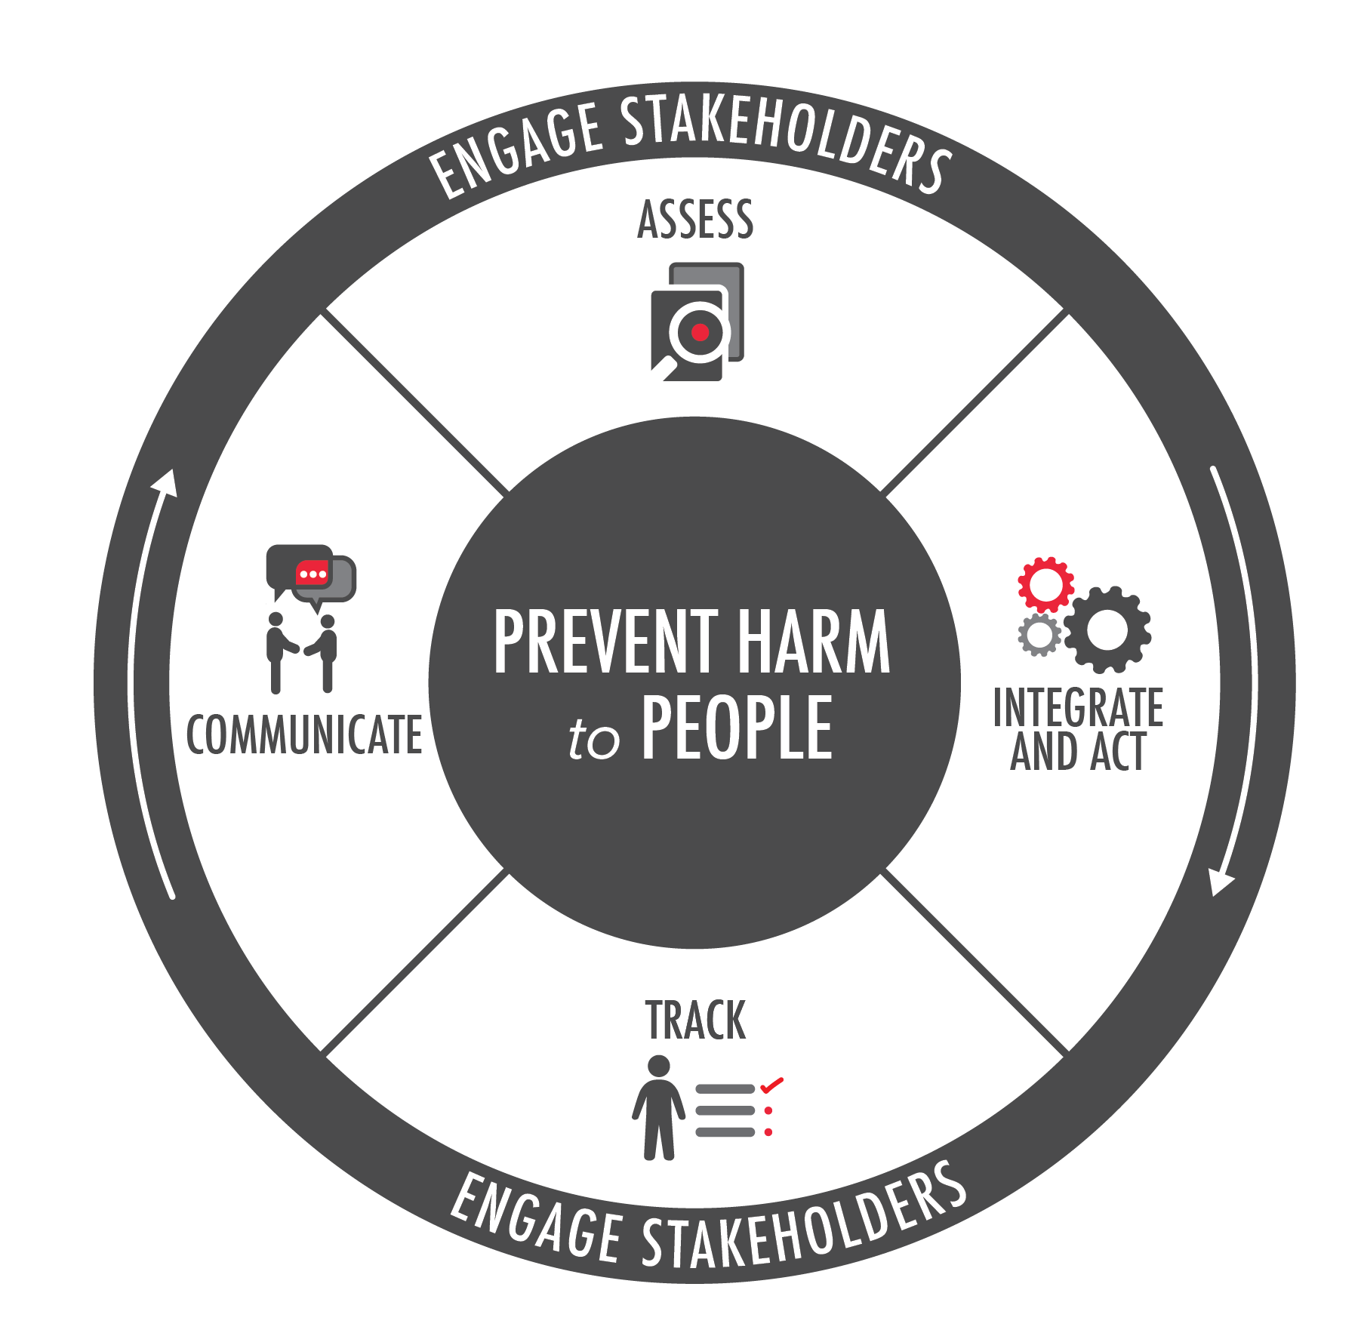
What are the drivers for human rights reporting?
Early days: CSR, risk to the business
International standards: UNGPs and OEDC Guidelines
  “In order to account for how they address their human rights impacts, business enterprises should be prepared to communicate this externally… and provide information that is sufficient to evaluate the adequacy of an enterprise’s response to the particular human rights impact involved” UNGP 21
UNGP Reporting Framework: translates the UNGPs into 31 straightforward questions
  ”This Reporting Framework puts the corporate responsibility to respect human rights into everyday language: a set of smart, straightforward questions to which any company needs to have answers – inside and outside its own walls.” John Ruggie
Cascade of new legislation, prominently the EU Corporate Sustainability Reporting Directive (CSRD)
Notes:
. It offers companies a powerful tool to deepen internal conversations, identify gaps in performance and drive improvements in practice

Slide 9
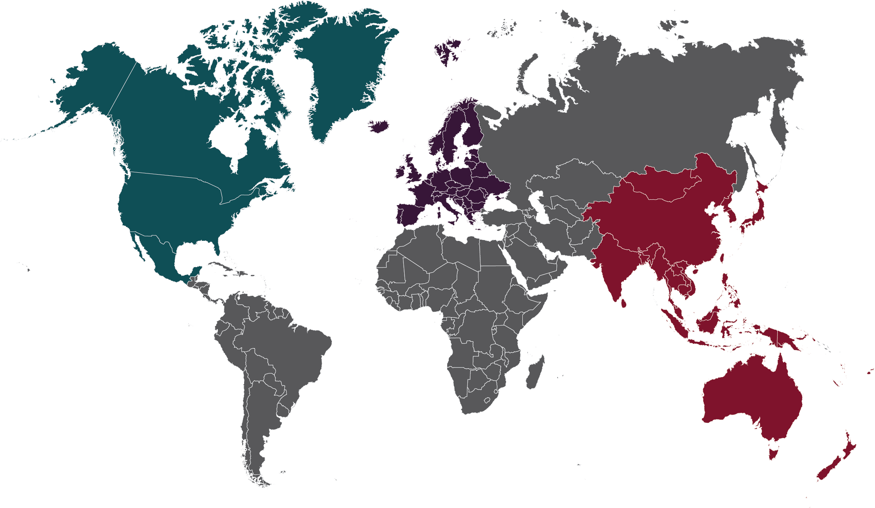
Rapidly Evolving Legislation on Human Rights
Europe
In force:
2015 UK Modern Slavery Act
2017 France Duty of Vigilance Law
2018 The Netherlands Child Labour Due Diligence Law
2021 Germany Supply Chain Law
2021 Norway Transparency Act
2022 Swiss Due Diligence Legislation
EU Corporate Sustainability Reporting Directive (in force from 1 Jan 2024)
EU Sustainable Finance Disclosure Regulation / EU Taxonomy
Proposed legislation on mandatory human rights due diligence in:
Netherlands
Belgium
Italy
Finland
Spain
Proposed EU level legislation:
Corporate Sustainability Due Diligence Directive
Regulation on deforestation
Forced labor import ban
North America
US Dodd-Frank Act on conflict minerals
US Tariff Act, Withhold and Release Orders banning goods made with forced labour
Uyghur Forced Labor Prevention Act
Canada S-211 Fighting Against Forced Labour and Child Labour in Supply Chains Act
Asia-Pacific
2018 Australia Modern Slavery Act
New Zealand Modern Slavery Act
Japanese government guidance on HRDD
NEW: South Korea: Proposed mandatory DD legislation
Notes:
ML
Legislation affects you as an investor as well as your investees
Both overarching human rights due diligence oriented as well as topically focused
Modern slavery legislation, child labour, deforestation
White & Case (law firm): 60% of legislation on human rights in company supply chains has been passed in the last 5 years
3 types of legislation:
1.Reporting requirements
2.Comprehensive due diligence
3.Forced labor import bans / product withdrawal
---
If enacted, South Korea could be the first country in Asia to introduce mandatory human rights and environmental due diligence obligations
Rapidly evolving legislation around the world on business & human rights
White & Case (law firm): 60% of legislation on human rights in company supply chains has been passed in the last 5 years
1) Legislation requiring reporting:
Modern Slavery Acts in UK and Australia
UK Modern Slavery Act ongoing consultation around updates – investor statement issued last week pushing for expansion of scope to include investors and downstream value chain, and a forced labour import ban
EU Corporate Sustainability Reporting Directive, requires reporting on ESG “double materiality” – impact on the company & on people, CSRD has been adopted and comes into force 1 Jan 2024. EU has produced draft social standards which require reporting on material impacts relevant to 4 main stakeholder groups: own workforce, workers in value chain, affected communities and consumers.
EU Sustainable Finance Disclosure Regulation (2021) requires respect for human rights as a baseline expectation for products and services to be considered “green” or “sustainable”
2) Requirement to do human rights due diligence:
France Duty of Vigilance (nb. upstream only)
German Supply Chain Law (nb. upstream only)
Norway Transparency Law
Proposed legislation at EU level – CSDDD*** (see below)
These laws reflect the concepts of the UN Guiding Principles – that is the responsibility of companies to do “due diligence” i.e. to take active steps to ensure that they are not connected to human rights abuses.
3) Forced labour import bans: In the US, goods “tainted with forced labor” can be seized at the border by Customs and Border Protection, under the Tariff Act, and new legislation focused on Uyghur Forced Labor
Other similar controls being debated in EU & Canada
(Note, Canada & Mexico already have a mechanism like the US WROs under the existing US-Mexico-Canada free trade agreement. Canada has used this mechanism to a limited extent. Canada’s proposed S-211 would add child labor to the existing forced labor ban under the USMCA)
***Detail on CSDDD:
The CS3D is currently being debated in the European Parliament, which is expected to adopt a position in May. There has been a lot of focus on whether and how the financial sector would be included
EU member states pushed for excluding investors from the scope of the legislation and creating an opt-in regime for other types of FIs.
Another earlier proposal was that FIs would only have to conduct DD in a pre-contractual phase (so no obligation to monitor the E&S performance of clients once the contract is signed)
The European Parliament will likely take an approach that is more in line with the UNGPs and with Shift’s views. In January, the relevant sub-committee deleted the restriction that FIs would only have to conduct DD in the pre-contractual phase, as well as the limitation to only conduct DD on the ‘own activities’ of FI’s business relationships. Investors also remain in scope.
Next steps are that Parliament, Member States and Commission will go into a reconciliation process (trilogue) to come to a joint version.
There will be a period for member states to transpose into domestic law, so the actual date when companies will have to comply may be much later (perhaps 2026, but that up for political debate)
Other details (if requested)
Canada:
(DRAFT) Reporting requirement: Bill S-211 Canada: reporting obligations for certain governmental and private sector entities on the steps the entity has taken during its previous financial year to prevent and reduce the risk that forced labour or child labour is used at any step of the production of goods in Canada or elsewhere
(pending, no updates since March 2022) Bill C-262: Under this bill, entities have a duty to prevent adverse impacts in its own operations (including affiliates) and as a result of its business relationships. Also includes a private right of action and the possibility to withdraw government support or funding, as well as the creation of a commissioner to ensure entities to publish a due diligence annual report
(IN FORCE) Swiss Due Diligence Legislation : It introduces general reporting obligations and specific conflict minerals and child labour due diligence obligations.
There is a parliamentary initiative to expand the scope of the text to include forced labour as a third topic.
GUIDELINES 2022: Japan Guidelines on Respecting
Human Rights in Responsible Supply Chains

Slide 10
Three buckets of legislative developments
1
Reporting
(CSRD, MSA, SFDR, Canada S-211…)
2
Due Diligence
(France Duty of Vigilance, German Supply Chain, CS3D…)
3
Import Bans
(US WROs, Uyghur forced labour, EU forced labour ban…)
Notes:
Import bans: not that they don’t require due diligence, but that’s not the main focus. Focus is on the finality – removing goods from the market that have been produced with forced labour.

Slide 11
How are these standards aligned?
Good news: there is increasing alignment!
Severity
Likelihood
”Severity is based on: (a) the scale; (b) scope; and (c) irremediable character of the impact.”
- ESRS 1

Slide 12
Identification and prioritization process for reporting and due diligence (CSRD / CSDDD)
D. Prioritize impacts for CSRD reporting
(hard threshold)
A. Understand the broad context
B. Identify all actual and potential impacts
C. Determine the severity and likelihood of negative impacts
D. Prioritize impacts for CSDDD action (sequencing)

Slide 13
Key indicators of good human rights reporting
Specific:
Identifies its most severe impacts on people (salient / material impacts)
Full value chain approach + all potentially affected stakeholders
Pinpoints the impact (where in the value chain, what kind of impact, by whom, etc.)
Does not confuse prioritization and action (i.e. severity vs cause/contribution/linkage)
Explains how respect for human rights is managed, including cross-functional structures and accountability
Explains what actions were taken
Explain engagement with affected stakeholders, civil society organizations, more critical stakeholders
Provides a view into future challenges and priorities
For double materiality specifically: engagement is not only focused on non-affected stakeholders
Cross-cutting:
Specificity / concrete examples
Openness to sharing challenges

Slide 14

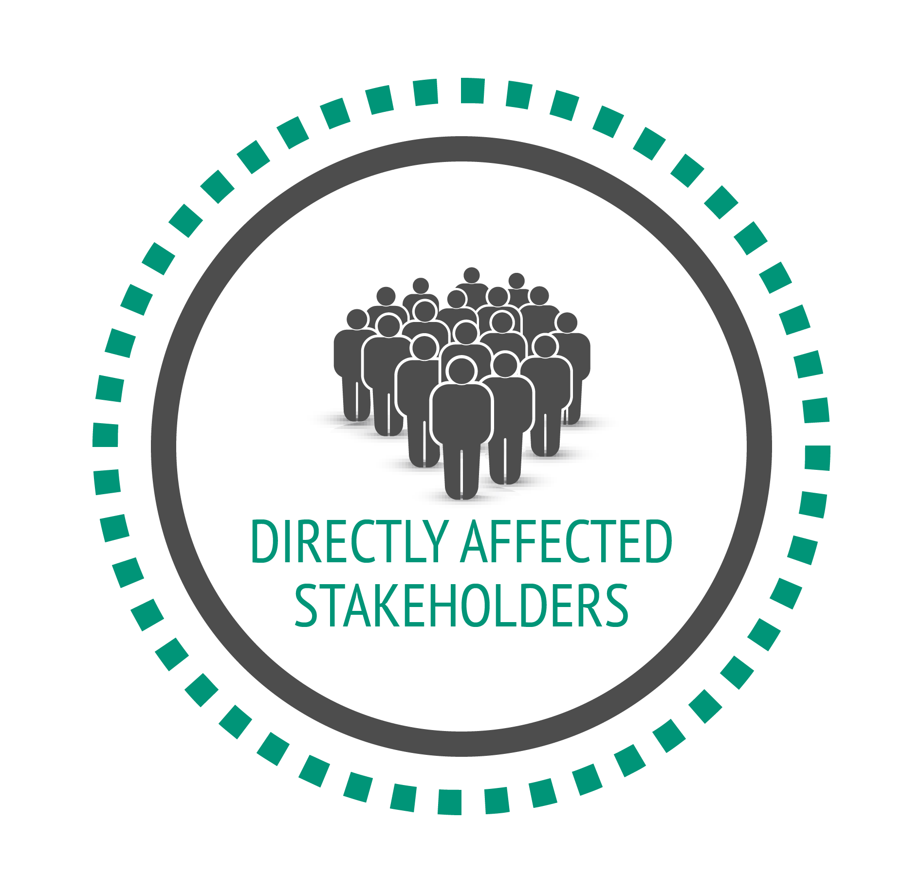

Who do we mean by stakeholders?
Notes:
ML
*Barclays report on EACOP, heavily criticized but interesting from a SE perspective
People who are directly affected
Where you can’t reach them, ‘credible proxies’ – eg. NGOs or CBOs that work with these groups
Human rights experts that can bring those perspectives
When we say stakeholders in the human rights context we mean the people who are directly affected by negative impacts.
Where you can’t reach them, you can go to ‘credible proxies’ – eg. NGOs or CBOs that work with these groups
Human rights experts that can bring those perspectives
In sum, the idea is for our due diligence to be properly informed by the perspectives of those who are living the impacts.

Slide 15
Affected and disclosure stakeholders in CSRD
Disclosure Stakeholders
NGOs
Investors
Academia
Government Entities
Topic Experts
Affected Stakeholders
Value Chain Workers
Communities
Indigenous people
HRDs
Employees
Trade Unions
Consumers

Slide 16
Stakeholders and their relevance to the materiality assessment process
For due diligence:
Engagement with affected stakeholders is central to the undertaking’s on-going due diligence process (see chapter 4 Due diligence) and sustainability materiality assessment. This includes its processes to identify and assess actual and potential negative impacts, which then inform the assessment process to identify the material impacts for the purposes of sustainability reporting (see section 3.4 of this Standard).
But for the materiality assessment:
“AR. 8 Materiality assessment is informed by dialogue with affected stakeholders. The undertaking may engage with affected stakeholders or their representatives (such as employees or trade unions), along with users of sustainability reporting and other experts, to provide inputs or feedback on its conclusions regarding its material impacts, risks and opportunities.”
Notes:
We can’t talk about impact materiality without addressing the central role of stakeholders.
Very quickly, there are two main groups of stakeholders: affected stakeholders, the people that can be affected by business, which were typically not part of the ”old” materiality process; and “stakeholders” more generally, which are users of sustainability information: investors, business partners, civil society organisations, analysts, etc.
ESRS 1 tells us, importantly, that engagement of affected stakeholders is central to the undertaking’s on-going due diligence process and sustainability materiality assessment. This includes its processes to identify and assess actual and potential negative impacts, which then inform the assessment process to identify the material impacts for the purposes of sustainability reporting. In other words, you engage affected stakeholders as part of due diligence, and that engagement informs your impact materiality process.
This goes to my earlier point, that realistically, you won’t be going to affected stakeholders with your materiality survey to rank whether issue A or B is more material. For those without a human rights due diligence process, reporting under the ESRS can be a catalyst. You can certainly use that opportunity to deep dive and identify salient issues with affected stakeholders and use that to inform your reporting under the ESRS, but for others who decide to not yet use that opportunity to conduct due diligence, it could involve talking to NGOs who understand your sector, to human rights experts, or trade unions that are often positioned at that higher level where they can speak to impacts on workers. But that’s not engagement with affected stakeholders. It’s a slightly different thing, and that’s where we usually see shortcuts made.
To inform the identification of material impacts:
“AR. 8 Materiality assessment is informed by dialogue with affected stakeholders. The undertaking may engage with affected stakeholders or their representatives (such as employees or trade unions), along with users of sustainability reporting and other experts, to provide inputs or feedback on its conclusions regarding its material impacts, risks and opportunities.”
To inform strategy and business model(s)
SBM-2: The undertaking shall disclose how the interests and views of its stakeholders are taken into account by the undertaking’s strategy and business model(s)…
To inform about social impacts:
S1/S2/S3/S4-2, e.g. Processes for engaging with own workforce and workers' representatives about impacts: E.g., The undertaking shall disclose its general processes for engaging with affected communities and their representatives about actual and potential impacts on them… to enable an understanding of whether and how the undertaking engages, as part of its ongoing due diligence process, with affected communities, their legitimate representatives, or with credible proxies, about material actual and potential positive and/or negative impacts that do or are likely to affect them, and whether and how perspectives of affected communities are taken into account in the decision-making processes of the undertaking.
To inform policies (MDR-Policies, para. 65)
To inform targets (MDR-Targets, para. 79)
As “beneficiaries” of actions (MDR-Actions, para. 68)
As users of channels to raise concerns (S1/S2/S3/S4-3)

Slide 17
So, what does meaningful engagement look like?
Engaging to gain insights in the course of due diligence, to inform the company’s understanding of impacts on people
  Salience assessment
  To deep dive on identified impacts and plan actions
  To better understand the context
  To collaborate on leverage strategies
Engage “in times of peace”
Be transparent about challenges and own limitations (especially for linkage to impacts!)
Feedback loop
Share information, not a one way street
Do your homework before engaging
Increasing demand on NGOs: be conscious of that

Slide 18
Feel free to reach out:
michelle.langlois@shiftproject.org
Notes:
ML
CSRD – ESRS
Directive and its standards that specify what needs to be reported, led by EFRAG (European Financial Reporting Advisory Group) Groupe consultatif européen sur l'information financière
Why are we talking about this?
Flurry of legislative developments
THE ESRS ARE SET TO APPLY TO MORE THAN 50,000 COMPANIES IN THE EU AND AT LEAST 10,000 COMPANIES OUTSIDE. To say the advent of the standards has generated a flurry of activity would be an understatement; companies are now bringing together parts of their organizations that rarely met before – finance and internal audit, compliance and legal, environmental teams and human rights specialists. There are questions about who should lead and whether and how these different experts might work together to apply the standards. And many companies are spending significant amounts of money on hiring consultants to guide them through the process.
So it’s understandable that we’re already seeing a proliferation of interpretations of the standards. The ESRS are hardly drafted in the most accessible terms – indeed, it seems to be the fate of many reporting (and other) standards, to be unhelpfully technical and complex in ways that risk undermining their actual intent.
In addition, consultants are often inclined to interpret standards in ways that best suit the methodologies they are used to applying with their clients.
Sustainability reporting should be a natural extension of action – to ensure the authenticity of insights provided to shareholders and other stakeholders, and to ensure that the data being gathered is of value for internal managers. It is this relationship that turns the costs of reporting into an investment in effective risk management. If a hundred interpretations of the ESRS now emerge, that prize will be lost.
2) how has materiality evolved over time?
Fundamentally, something that is “material” is very important or of great consequence, it can influence a decision.
But what is “important” always depends on the choice of a particular audience or goal for which things are then judged more or less important.
Traditionally, the audience has been shareholders, but the audience can be much broader.
The goal behind what gets identified as material also matters; it can be profit-making alone, or decisions of an investor more widely, but it can also expand to societal welfare.
So financial materiality has long focused on shareholders and profit-making as the main goal.
And in the last 25 years or so, especially in the last decade, we’ve seen a growth in sustainability reporting, with a focus on matters that reflect an organization’s impacts on people, planet and the economy. So a broader audience and a broader goal than financial materiality. But still a changing audience or goal. Materiality as something that varies, that’s somewhat unpredictable.

Slide 19
Thank you for attending!
To view past CR2R webinars, please visit the CR2R webpage here.
To learn more about our Corporate Human Rights Benchmark Coordinated Corporate Engagement, please visit the CHRB page.

